Slide 1
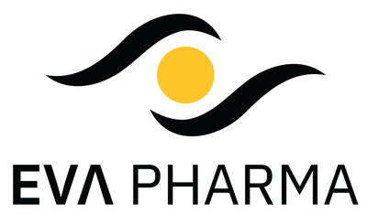
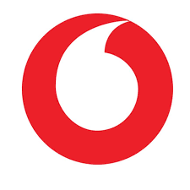
Blood Donation Management System
Connecting Donors, Hospitals, and Health Authorities

Slide 2
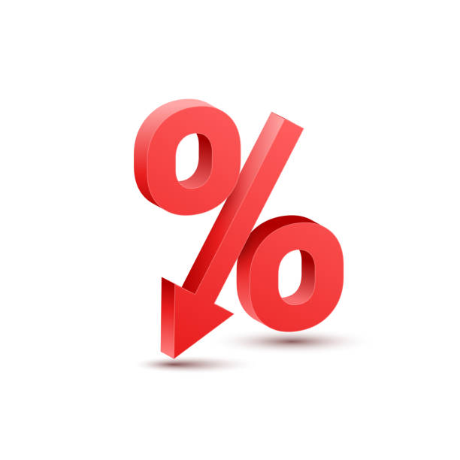
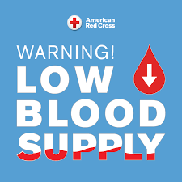
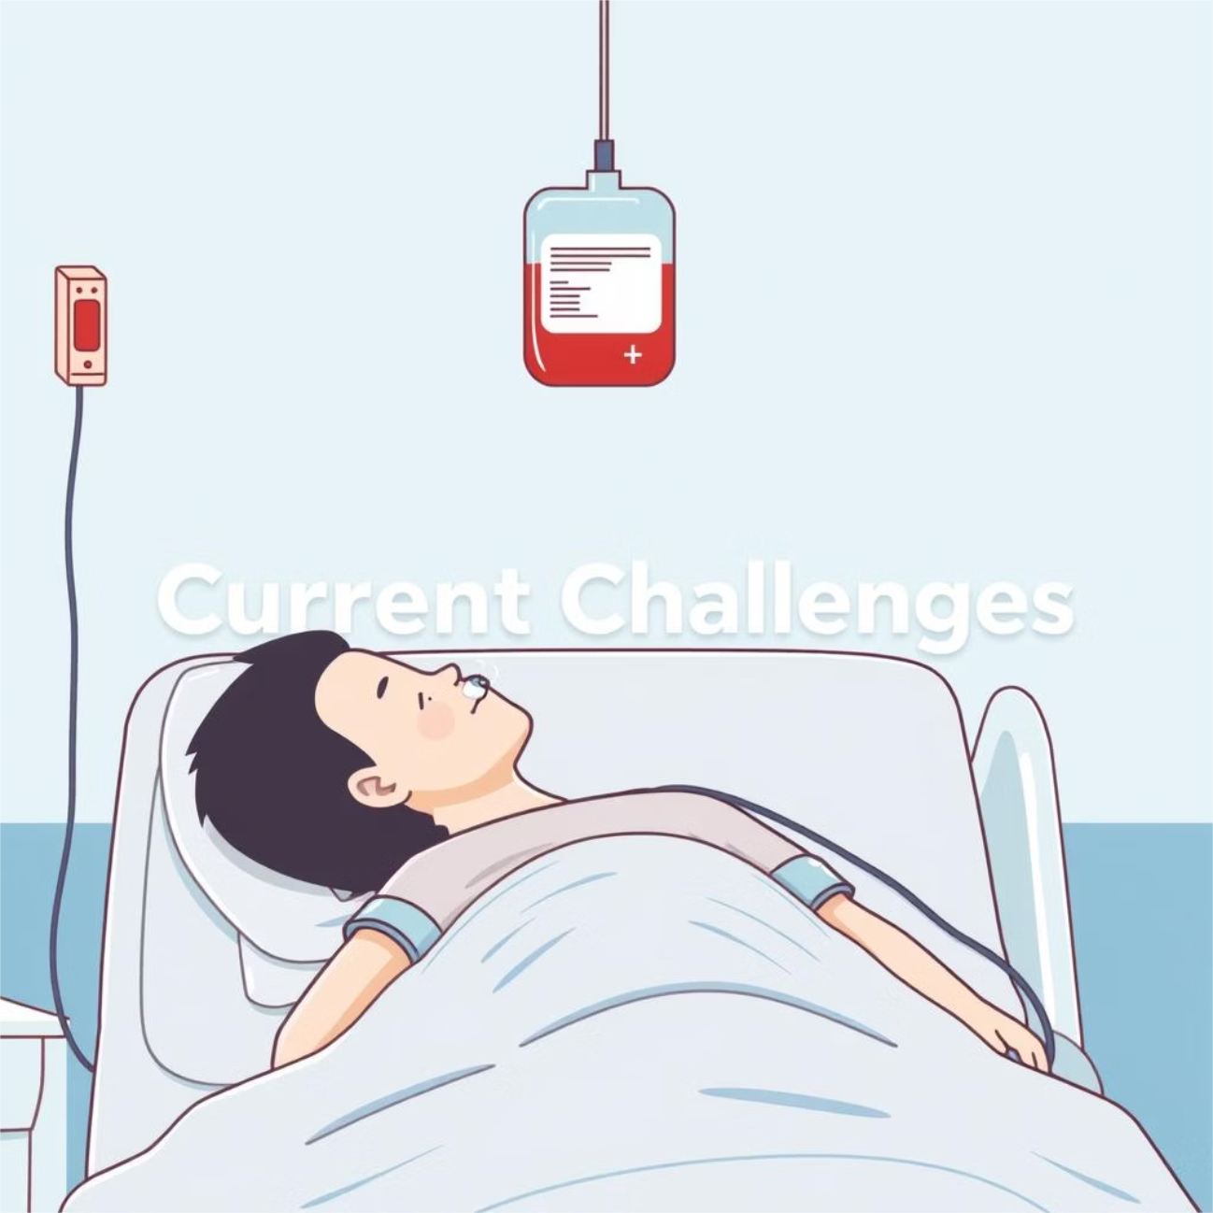


The Critical Need: Addressing Blood Shortages
1% Donation Rate
Chronic Shortages
Emergency Delays
Location Mismatch
ManuaL Outreach

Slide 3




Our Solution: A Unified Blood Management Platform
Our project aims to develop a comprehensive system that streamlines the entire blood donation ecosystem, focusing on these core objectives:
Donor Management
Inventory Tracking
Manual Requests
Donor Motivation

Slide 4






Key Stakeholders in Our Ecosystem
Hospitals
Donors
Admin: Health Authorities

Slide 5

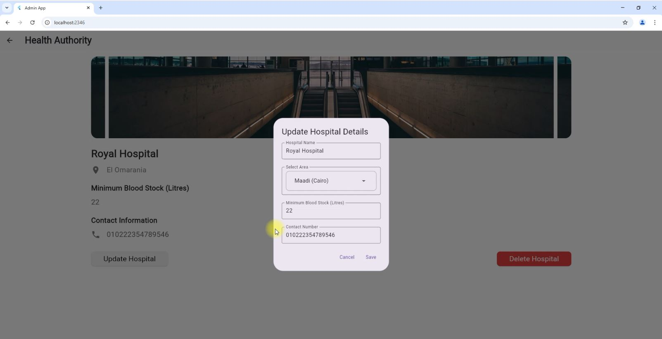
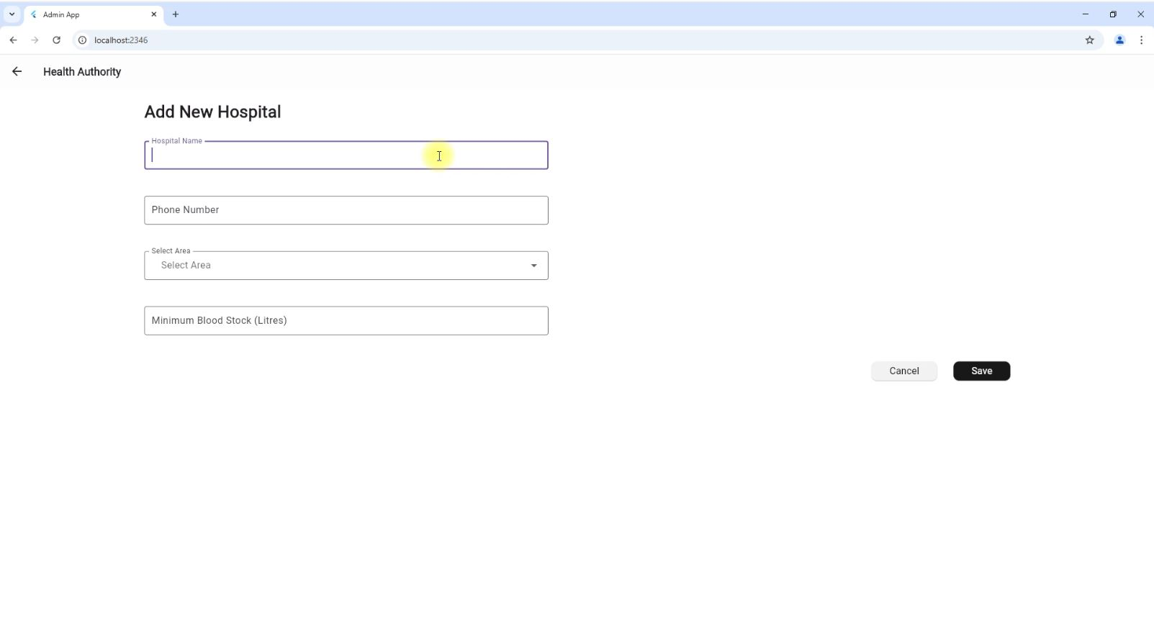
Admin Oversight: Ensuring System Integrity and Standards
The administrative module provides comprehensive control and monitoring capabilities, vital for maintaining
the system's integrity and adherence to health standards:
Hospital Account Management
Hospital Data Entry

Slide 6
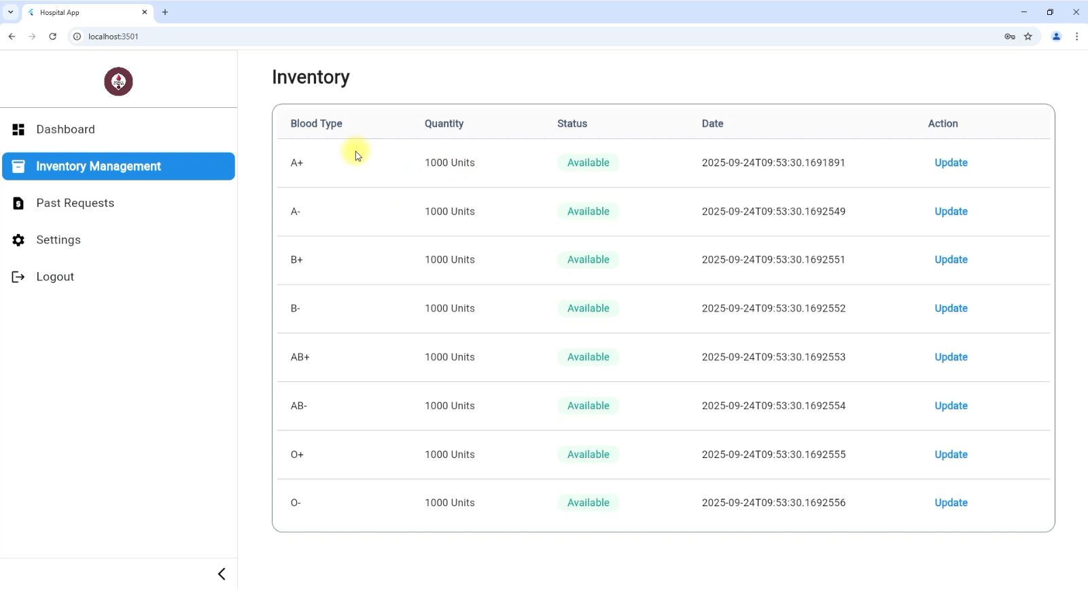
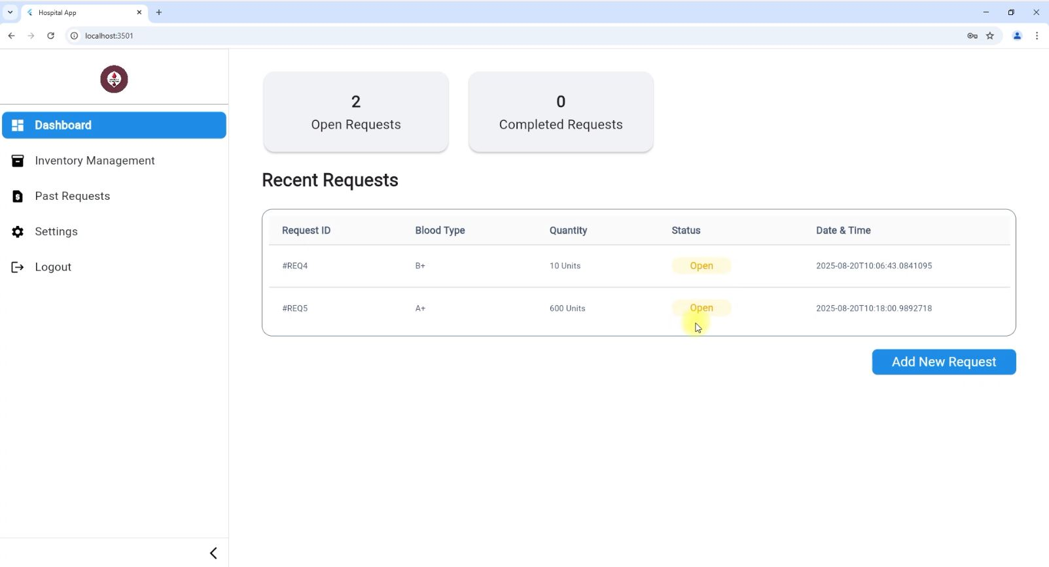
Hospital Interface: Streamlined Stock Management
Hospitals gain unprecedented control and visibility over their blood inventory with features designed for efficiency
and rapid response:
Create Donation request
Blood Inventory Management
Update & Expiration Tracking

Slide 7
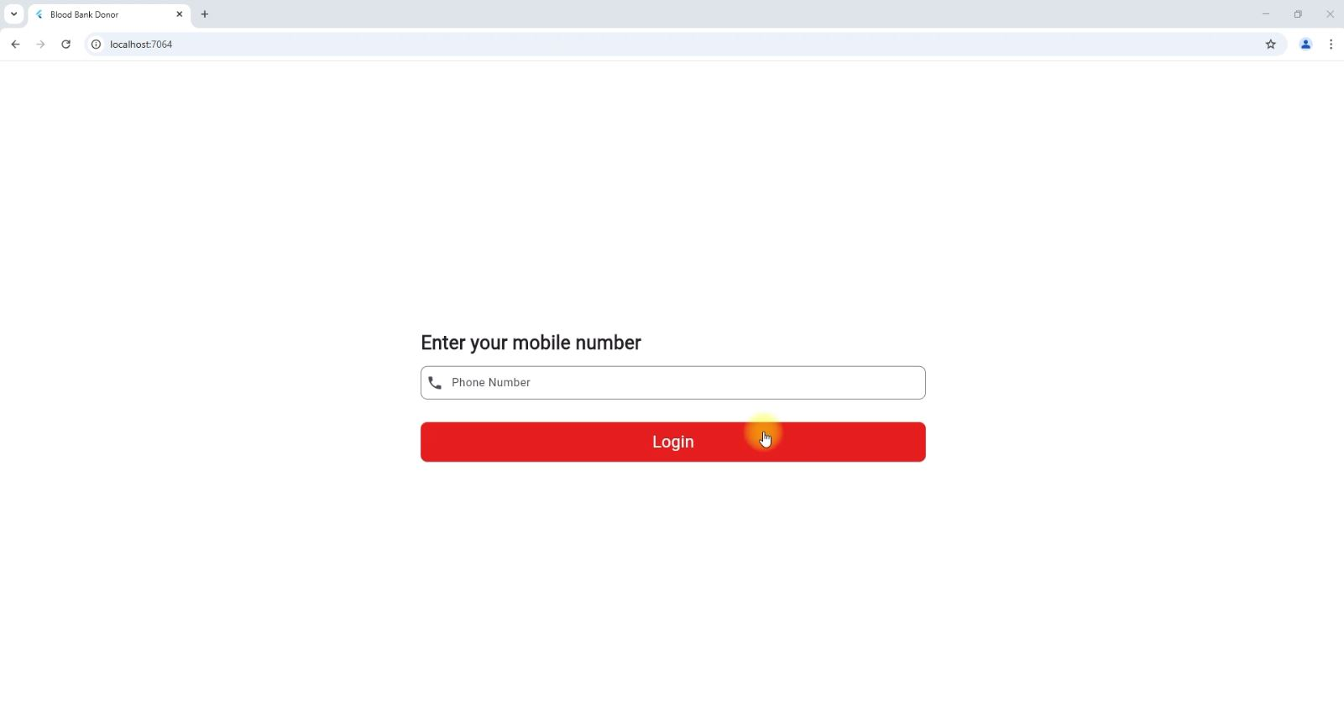
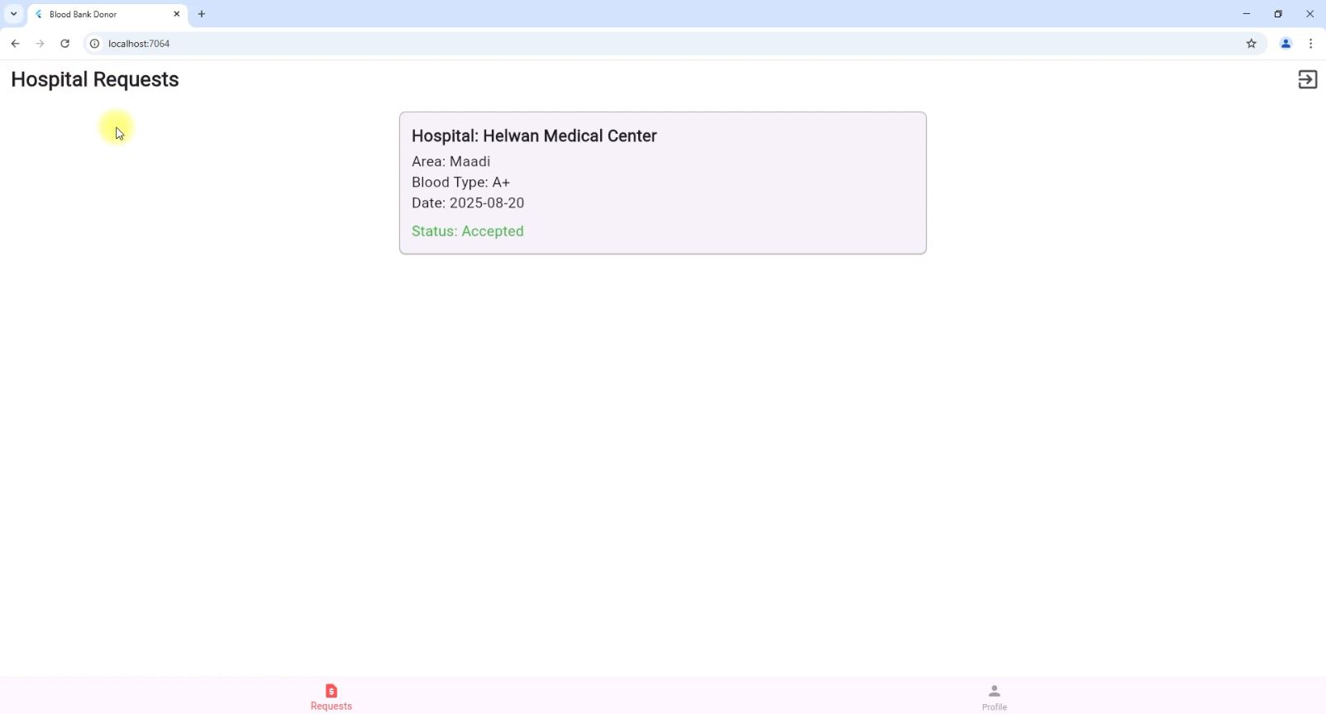
Empowering Donors: Seamless and Rewarding
The donor-centric features are designed to make the donation process easy, transparent, and encouraging:
Effortless Registration
Targeted Requests

Slide 8
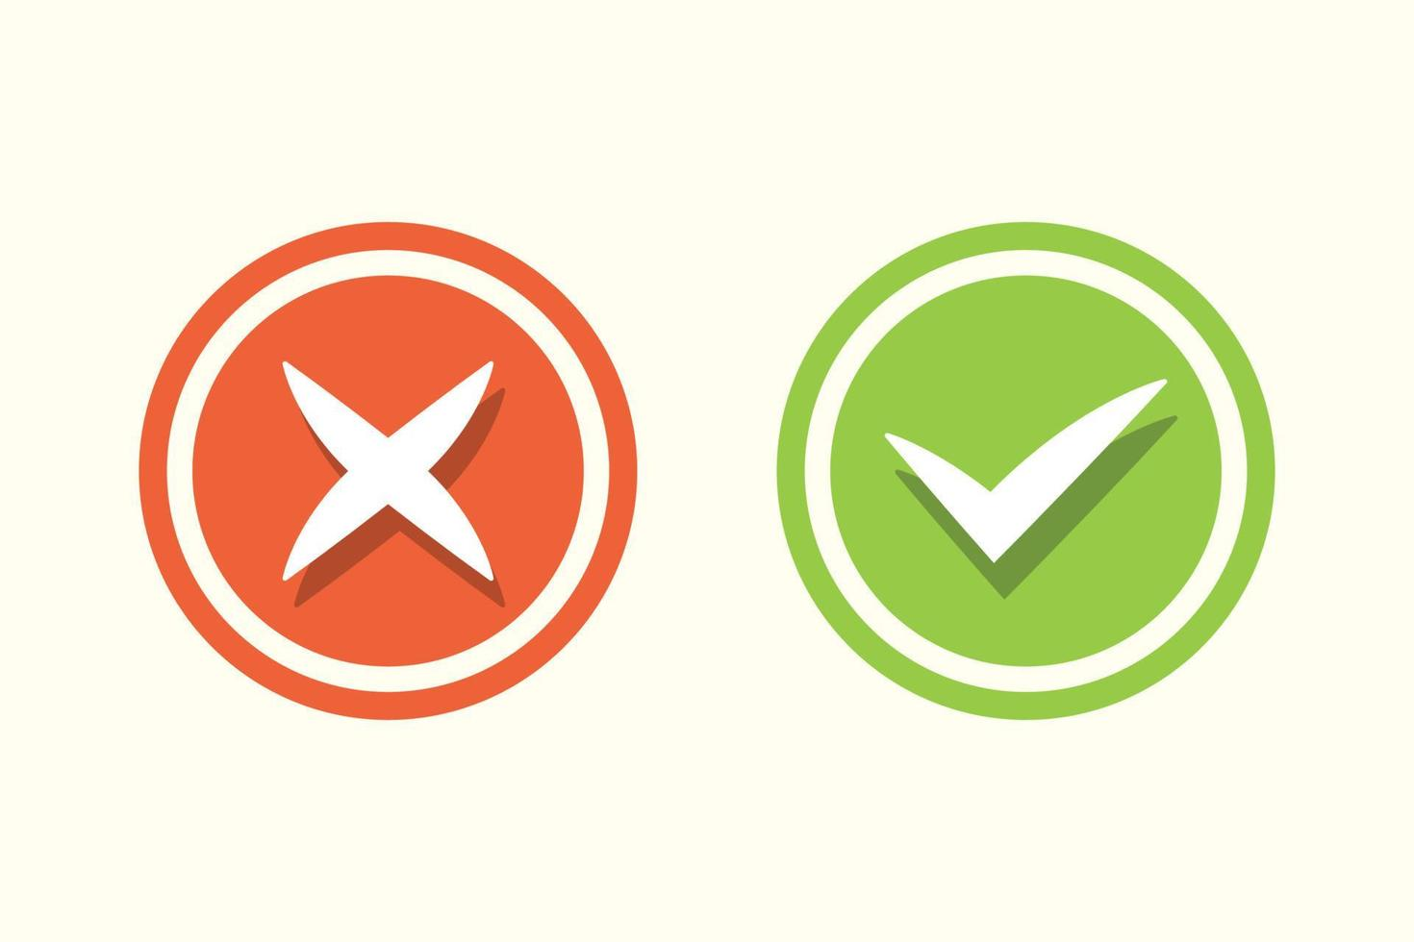

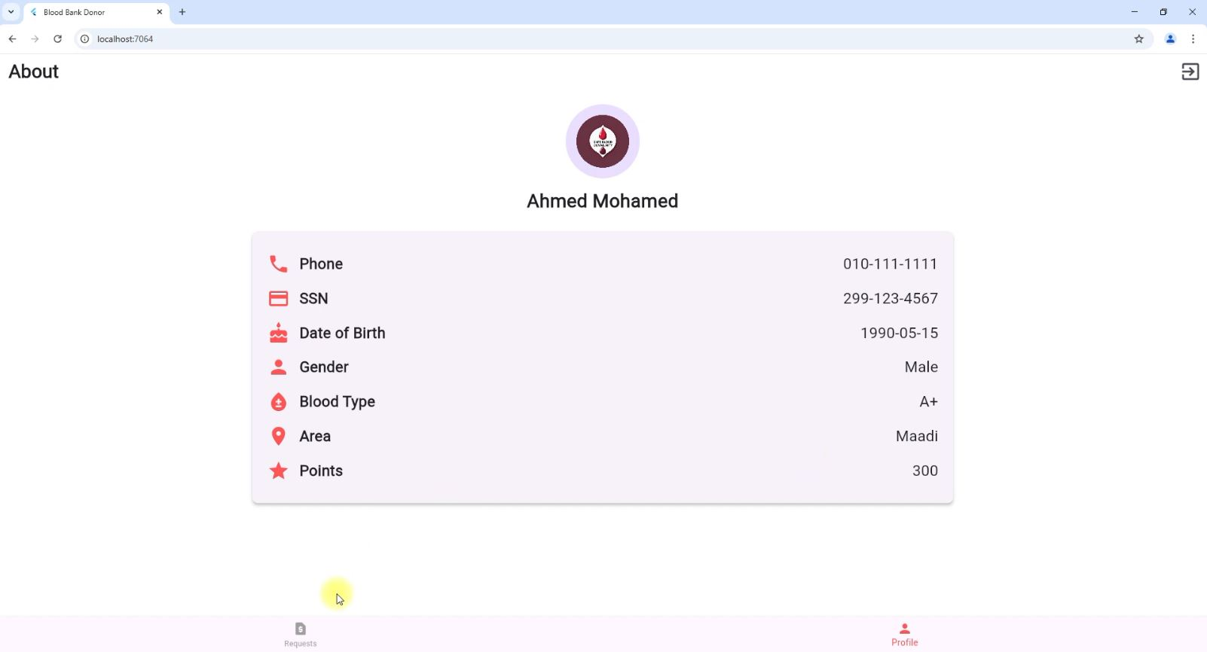

Flexible Response
Incentivized Giving
Valuable Rewards

Slide 9






Workflow: Hospital Donation Request
This intelligent process ensures timely blood supply based on real-time hospital needs.
Hospital Creates Request
System matches & Sends
Donor Response & Points

Slide 10
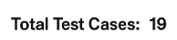
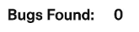
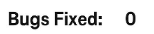
Test Case Summary
Total Test Cases

Slide 11









Conclusion & Future Work
Faster, Safer, Smarter Donation
Donor Motivation
Reliable Inventory
Our system revolutionizes blood donation by integrating efficiency, donor motivation, and reliable inventory management. This foundation sets the stage for significant advancements in public health.
National Integration
Advanced Analytics
Intuitive Mobile App
Expanding to a unified national network.
Predictive insights for demand and supply.
Enhancing accessibility for donors and staff.

Slide 12

Thank You

